Slide 1
New Life Jacket Labels
The traditional “Types” categories are going away.
New labeling system relies more on icons and less on wording.
Older jackets and flotation aids labeled by “type” still meet regulatory requirements until no longer serviceable.
Two Categories:
Wearable
Throwable
Wearable life jackets will be divided into five buoyancy categories: 50, 70, 100, 150, and 275 Newtons (metric to harmonize with Canadian standards
Copyright 2020 - Coast Guard Auxiliary Association, Inc.
Notes:
For the past several years, the U.S. Coast Guard has been moving away from the Type I – V life jacket labeling. The U.S. labeling system will now be consistent with the International labeling system. This is particularly a positive move to align both American and Canadian life jacket labels. The new labels will show more icons and less words to make it easier to determine which life jacket is best. Going forward, flotation devices are either “wearable” or “throwable.”
The term “life jacket” is preferred to represent a device that will turn, or is likely to turn a person face up in the water. A “PFD” is a device that simply keeps a person float, but not necessarily turn a face down person face up. A PFD relies on the person’s ability to help themselves float.
Buoyancy will be categorized in 5 levels - 50/70/100/150 and 275. As an example, 70 represents 15.5 pounds of buoyancy.

Slide 2
New Icons
Choose the level of buoyancy for the type of activity.
The curved arrow indicates that it is likely to turn an unconscious wearer face up in the water.
Copyright 2020 - Coast Guard Auxiliary Association, Inc.
Notes:
The new buoyancy levels are based on “Newtons”, which is a math calculation used by Sir Issac Newton. These levels include:
• Level 50 for paddle board use or use close to shore where help is likely to happen quickly.
• Level 70 for inflatables, active wear, with help nearby.
•Level 100 provides more performance than the Level 70, better buoyancy.
• Level 150 - off shore use where help Is not likely for some time. This device will keep you face up.
•Level 275 heavier duty for commercial and industrial use.
The labels will also indicate whether for use by Adults, Youth, Toddler, or Infants. You will also need to look at the weight and chest measurements for best fit. The choice of buoyancy will be an individual's, not mandatory.
The use of the curved-arrow icons will indicate how effective the life jacket will turn a person face up or not.

Slide 3
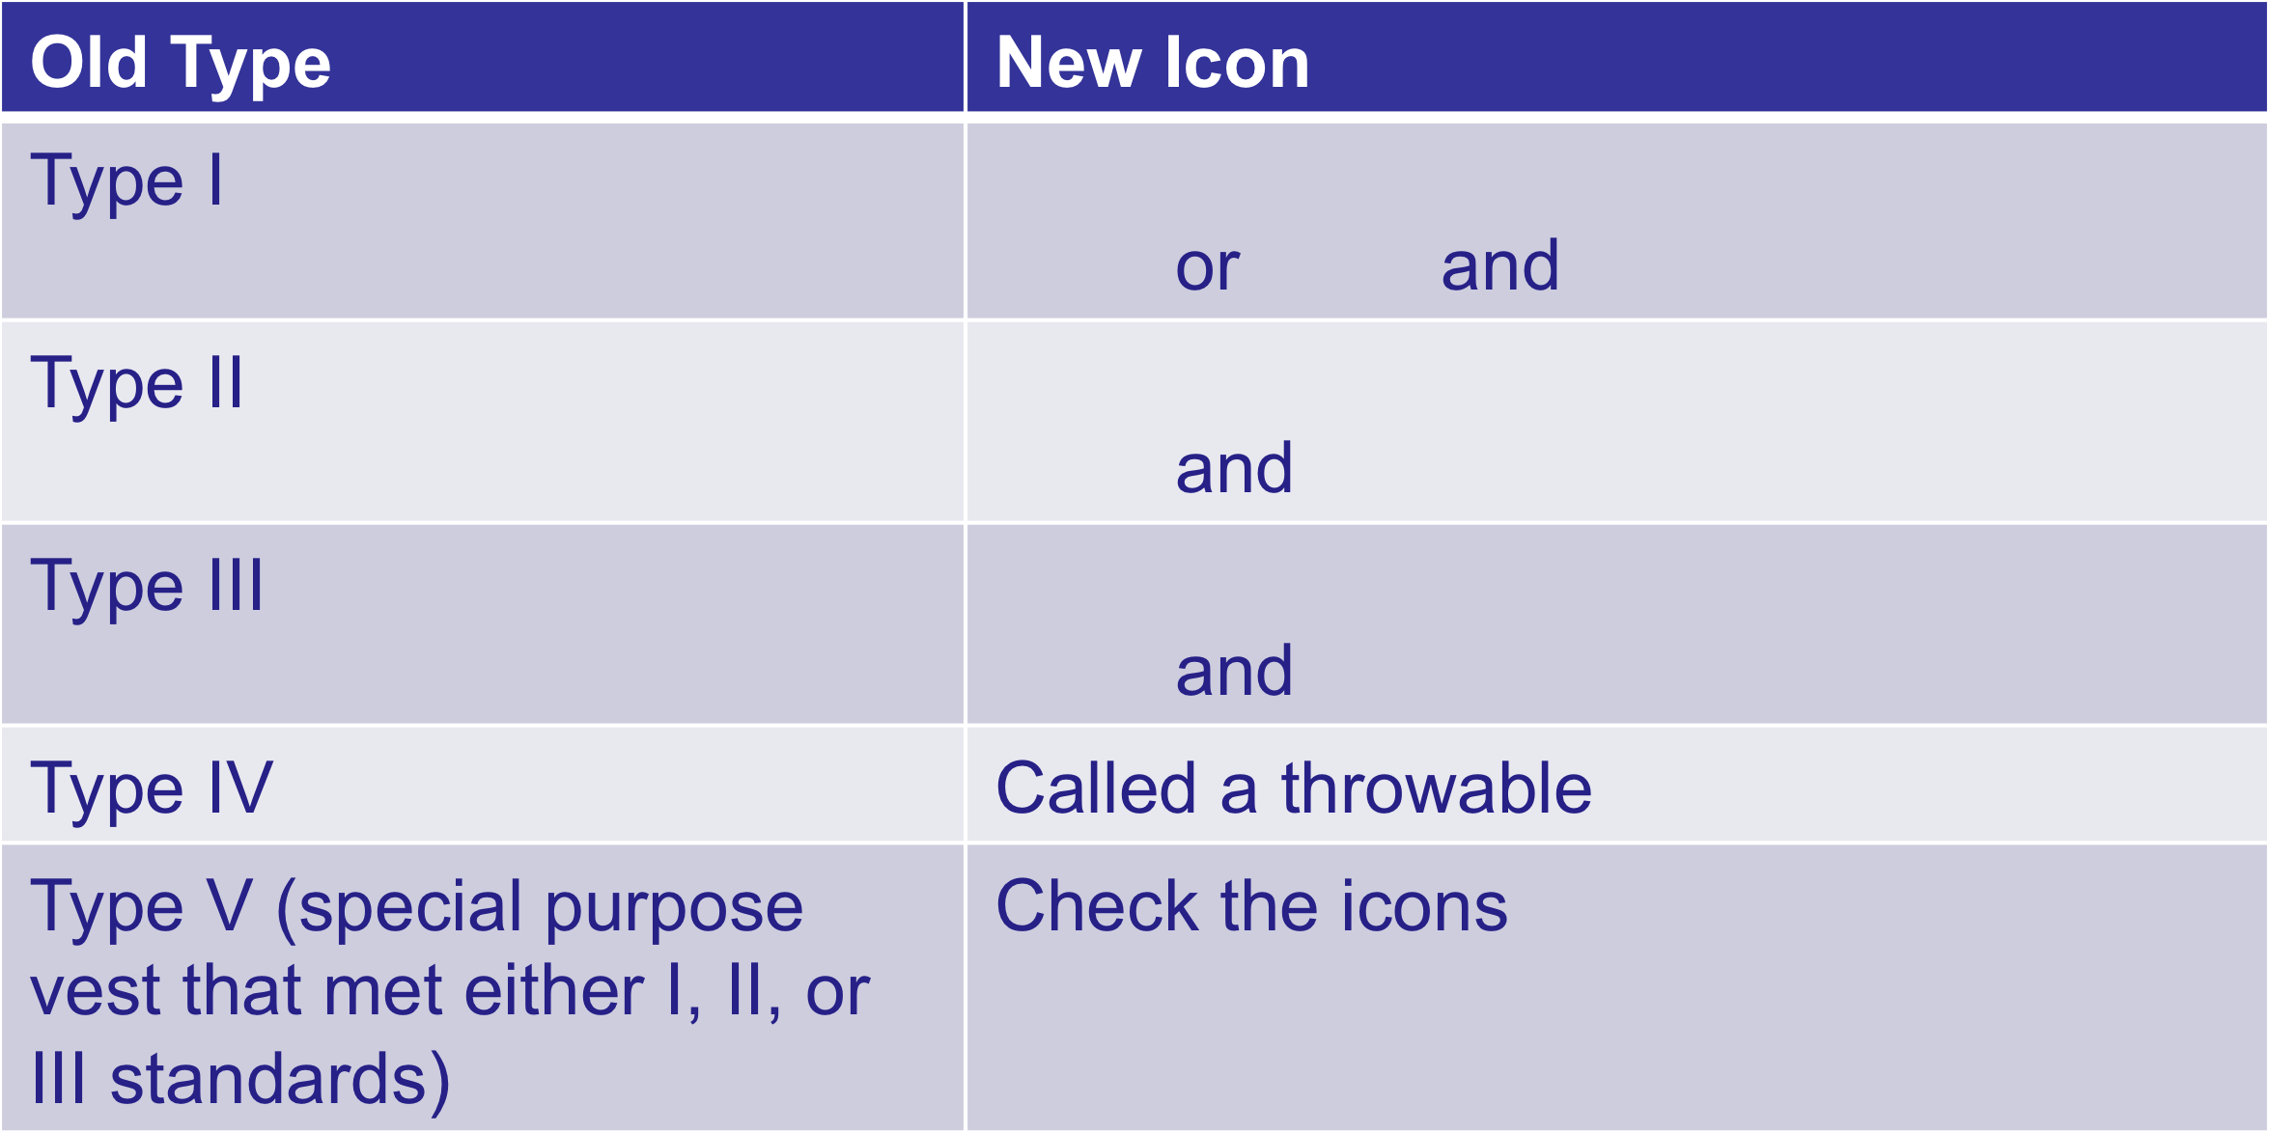
Comparison
Copyright 2020 - Coast Guard Auxiliary Association, Inc

Slide 4
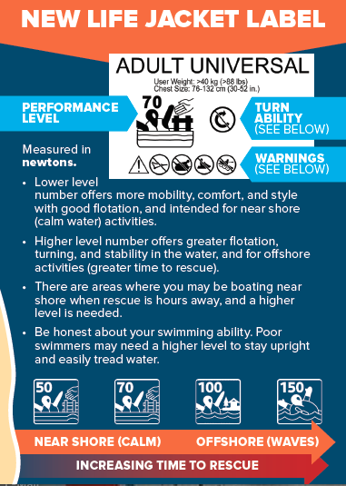
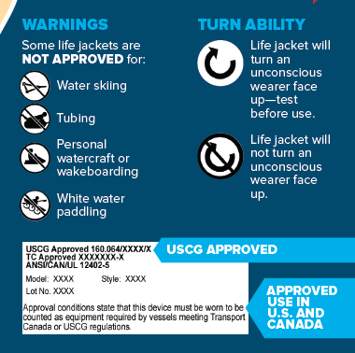
New Life Jacket Labels
Copyright 2020 - Coast Guard Auxiliary Association, Inc

Slide 5
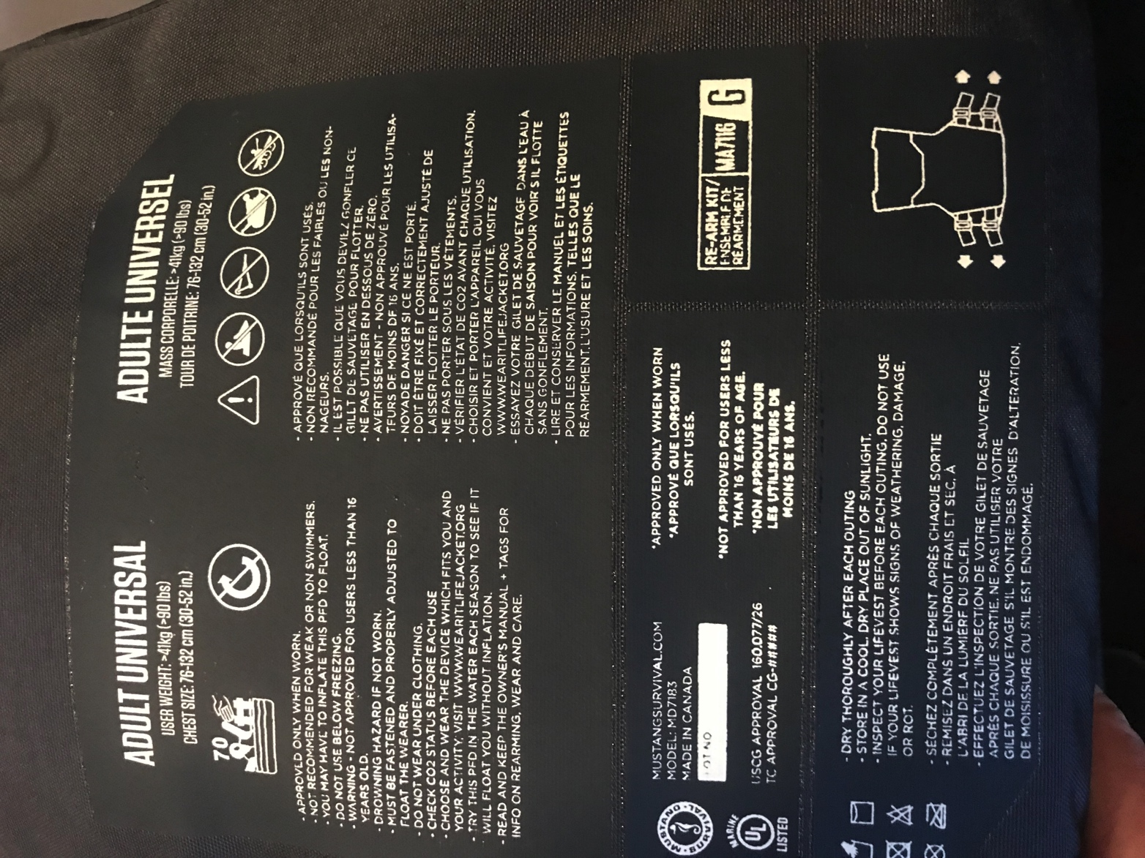
Life Jacket Label Sample (Inflatable)
Limitations of Use (No PWC, Skiing, Towing, Whitewater Paddle)
Will Not Turn You Face Up
Buoyancy Level (70)
Care
Copyright 2019 - Coast Guard Auxiliary Association, Inc

Slide 6
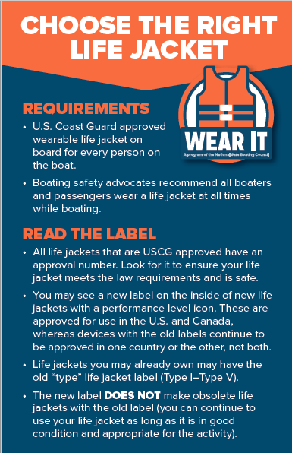
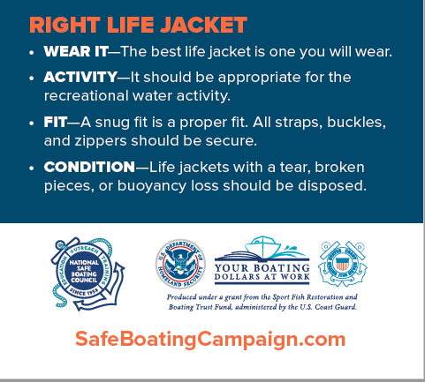
No Matter Which
Label…
Copyright 2020 - Coast Guard Auxiliary Association, Inc

